Slide 1




WinRT & Caliburn.Micro
Karlkim Suwanmongkol
@kimsk
http://karlk.im
karlkim@outlook.com
Notes:
I have very strong accent, and it gets worse when I am excited and speak too fast..
Please feel free to interrupt me if you don’t understand anything ☺.

Slide 2

Agenda
WinRT
XAML and MVVM
Caliburn.Micro
Overview
WinRT specific
Conventions
Actions
Event Aggregator
Misc.
Notes:
Today I will begin the talk with Windows Runtime or WinRT
Next talk a little bit about XAML and MVVM
Then I will talk about Caliburn.Micro starting with
A little bit of history
Overview about WinRT and Caliburn.Micro
And go to each topic by showing some slide and demo code
Caliburn.Micro
Overview
Conventions
Actions (Where is ICommand?)
Event Aggregator
WinRT specific
CaliburnApplication (Where is Bootstrapper)
WinRTContainer
Navigation
Sharing
Settings
Misc.
Design-Time support
PCL

Slide 3


Windows Runtime
Windows Store
Metro style Apps
Desktop Apps
View
XAML
HTML / CSS
HTML
JavaScript
“Our strategy has shifted.“
Bob Muglia
Model Controller
C/C++
C#, VB
JavaScript
(Chakra)
C
C++
C#
VB
Windows Runtime APIs
System Services
Communication
& Data
Graphics & Media
Devices & Printing
“Silverlight is dead, Long live Silverlight!”
Tim Heuer
Application Model
Internet Explorer
Win32
.NET SL
Kernel
Windows Kernel Services
Notes:
Every Silverlight developer has to remember PDC 2010 when Bob Muglia said “Our Silverlight strategy and focus going forward has shifted.”
And there were a lot of rumors about Microsoft was going all-in with HTML5 and might abandon XAML or even .NET in Windows 8.
What bothered developers were that Microsoft didn’t say anything and want us to wait for the 1st BUILD conference.
http://blogs.msdn.com/b/silverlight/archive/2010/11/01/pdc-and-silverlight.aspx
http://timheuer.com/blog/archive/2010/11/01/silverlight-is-dead-long-live-silverlight.aspx
At BUILD 2011, Microsoft officially introduced Windows 8 and how to develop apps for their new platform with Windows Runtime or WinRT.
The green side is WinRT and the blue side is the desktop apps, .NET, Win32
It turned out that WinRT does support HTML5, but it also supports XAML/C#/VB and C++ stacks as well.
Applications developed by using WinRT are known as Windows Store apps or Metro-style apps. That's why many people including me also use term WinRT app to refer to Windows Store app. (However, in the future, Microsoft might let people develop other kind of apps using WinRT; Wild guessing)
Original diagram from Lap around the Windows Runtime at BUILD 2011
http://channel9.msdn.com/Events/Build/BUILD2011/PLAT-874T
WinRT app developed using .NET (XAML/C#/VB/F#) is still running on CLR which is the same CLR.dll that runs .NET 4.5 app. However, WinRT app is using a subset of APIs and is using different profile (e.g., client profile)

Slide 4
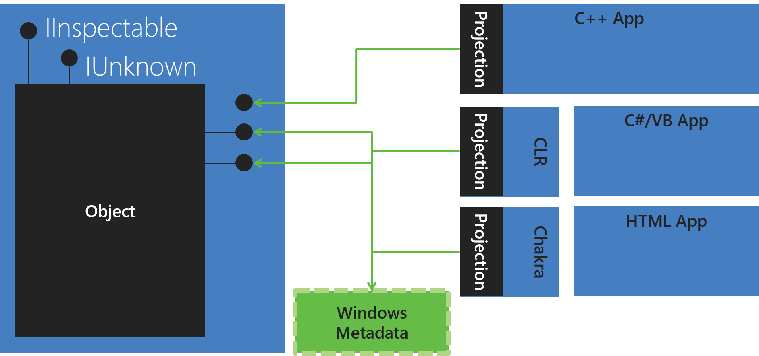
WinRT Projections
“Is COM dead? It’s not dead. It’s done.”
Don Box
Notes:
Original diagram from Lap around the Windows Runtime at BUILD 2011
http://channel9.msdn.com/Events/Build/BUILD2011/PLAT-874T
So what is WinRT?
Behind the scenes, WinRT is a new set of COM-based (e.g., every WinRT object implements IUnknown and does refcounting) native APIs on the Windows 8. The API definition is defined in WinMD metadata format similar to .NET.
If you have done COM, you should remember the old friend, IUnknown
Besides creating modern APIs that is cloud-ready, sandboxed, the design objective of WinRT is creating APIs that is accessible to .NET and JavaScript developers. WinRT exposed their APIs to C/C++, JavaScript, and .NET stacks through "projections mechanism (IInspectable)."
Fortunately, as a .NET developer, we don’t need to worry about it. Besides, emphasis on asynchronous and API changes, the programming model is pretty much the same.
The metadata is stored in .winmd file like .NET

Slide 5
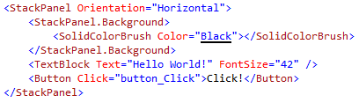
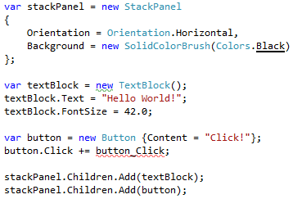
XAML & MVVM
View
XAML – eXtensible Application Markup Language
Model-View-ViewModel
MVVM is a natural pattern for XAML
Data Bindings with INotifyPropertyChanged
Command Bindings
Behaviors
View (XAML)
Bindings
Commands
ViewModel
ViewModel
Exposes
Model
Model
Notes:
XAML – Extensible Application Markup Language
If you have done WPF or Silverlight, you should be familiar with XAML which is a declarative XML-based language also available on Windows Phone, and WinRT.
Although it is a mark up language like HTML, but XAML elements are real objects with properties
When we talk about XAML-based application development and Caliburn.Micro, we will always hear MVVM.
What is MVVM?
Model: Data, Services, Business Logic etc.
View: UI, Interaction, etc.
ViewModel: View Logic, Data management, An object that purely represents state to the view
Model-View-ViewModel is one of the UI architecture patterns similar to MVC (ASP.NET MVC) and MVP (WinForms). They provide clean separation of concerns between Presentation and Data. Model and View are the same for all patterns, the differences are ViewModel in MVVM, Controller in MVC, and Presenter in MVP,
One way to think about these patterns is how they treat state. Controller is completely stateless and event driven while ViewModel is completely stateful and eventless while Presenter is in the middle. (http://www.infoq.com/articles/Rob-Eisenberg-Caliburn)
MVVM is a natural pattern for XAML because of the rich data bindings capabilities that bind View and ViewModel loosely.
Rich Data Bindings
Data
Commands

Slide 6
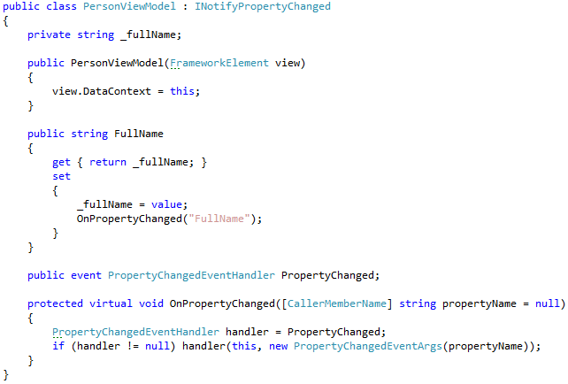


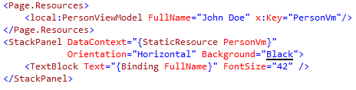
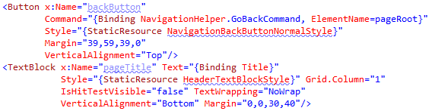
But How?!
View or ViewModel first?
How I bring them together? Should they know each other?
XAML Bindings can be verbose
Later, you may need
Dependency Injection container
Publisher/Subscriber capability
Blendability
Etc.
View (XAML)
Bindings
Commands
ViewModel
Exposes
Model
Notes:
But how we can use MVVM pattern with XAML?
We know we should implement model in a data layer or web services somewhere.
View should be in XAML
ViewModel is somewhere between our View and Model
And Out-of-the-box, you can do MVVM with binding, ICommand, INPC, etc.
But as your application grows, many questions arise.
Where and how to instantiate View and ViewModel and links them together?
Beginners have done something like these…
XAML is declarative which is good, but bindings can still be very verbose.
Later you may need IoC container (some people called it DI container), Pub/Sub implementation
Blendability or design-time support

Slide 7
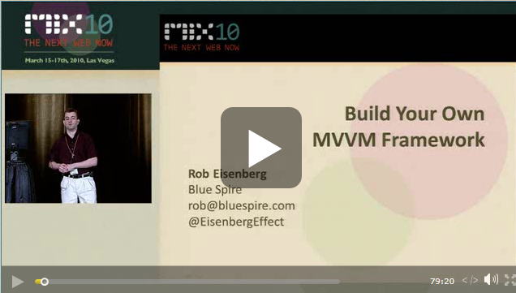

Caliburn.Micro
Rob Eisenberg (@EisenbergEffect)
Caliburn Project
“Build Your Own MVVM Framework” at MIX 2010 conference
Supports WPF, Silverlight, Windows Phone, and WinRT
https://caliburnmicro.codeplex.com/
Current version : 1.5.2 (Also available via NuGet)
Version 2.0 based on Portable Class Library (PCL) is coming
Notes:
Rob Eisenberg from Blue Spire
When WPF first came out (2006?), MVVM pattern was not so widely-known. Early adopters were trying to leverage data bindings and commands effectively. Rob came up with Caliburn to help his company develop WPF applications for his clients,
Caliburn has a lot of cool concepts such as ViewLocator, Actions, Coroutines, etc. and he presented these concepts in a demo framework at his session, “Build Your Own MVVM Framework” at MIX 2010.
After the talk, many people had come to him and expressed an interest in an official version of what were shown at the conference. Hence, the Caliburn.Micro project was born,
It is an open source project in CodePlex and very active.
The current release version is 1.5.2, but the version 2.0 preview that is based on PCL is coming.
Although, breaking API changes are expected with version 2.0, many concepts that I will be talking about today should note change.

Slide 8


WinRT & Caliburn.Micro
Bootstrap via CaliburnApplication
WinRTContainer
View-First to prepare Navigation service
Charms
Setting
Share
Notes:
Every XAML-based application seems to have different way to start the application. In WinRT app, Windows.UI.Xaml.Application acts as a app entry, so Caliburn.Micro doesn’t use Bootstrapper like in WPF, Silverlight, or Windows Phone version.
Caliburn.Micro comes with a simple IoC container, but for WinRT, it also comes with specialize version
You can still do either View-First or ViewModel-First for app initialization, but to use Navigation service, you have to do View-First. Navigation is a native WinRT way to go from one page to another page. It also keep track of page stacks, so you can provide go-back button to users similar to browser.
After the initialization, you can then use ViewModel-First which is the preferred Caliburn.Micro way.
Every Windows Store app can support what is called Charms (show the real charms, Search, Share, Devices, and Settings)
To support Setting charms, it can be cumbersome, and Caliburn.Micro can help. (App.xaml.cs and OptionsView)
In Windows 8 and existing NuGet version (1.5.2), it used to depend on Callisto which is a toolkit created by Tim Heuer. http://timheuer.com/blog/archive/2012/05/31/introducing-callisto-a-xaml-toolkit-for-metro-apps.aspx
Windows 8.1 now has a Flyout control and Caliburn.Micro v 2.0 is using that instead
WinRT app can be both Share source and Share target, in the Instant Bingo app, I make it a Share source, and we just have a ViewModel that we wants it to act as a Share source implements ISupportSharing. (PatternsViewModel)

Slide 9
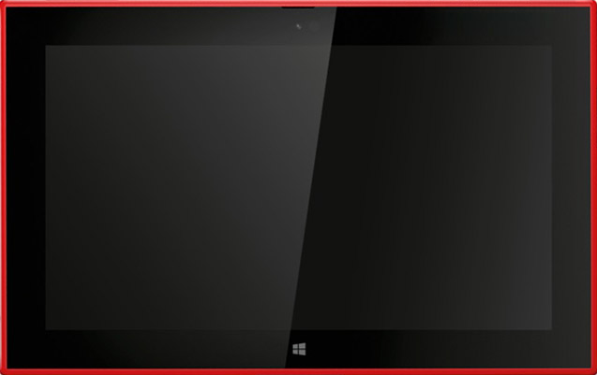
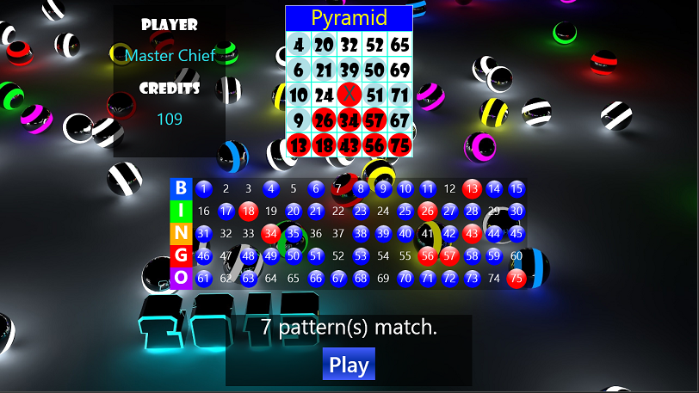
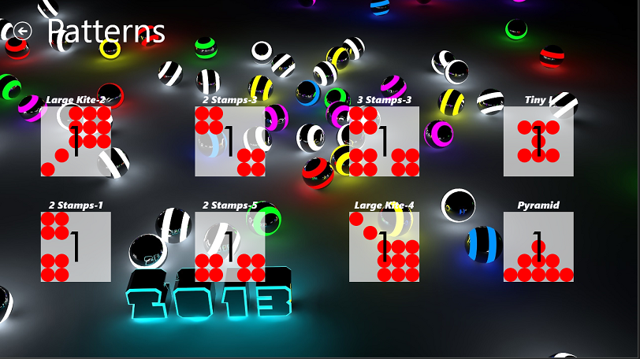
Instant Bingo
Notes:
To show how we could use Caliburn.Micro, I prepare a simple game (no skills involved)
If you are interested, model part is written in F# while the Views and ViewModels are in C# and XAML.
Based on a bingo game
5 by 5 bingo card
Number of balls are called instantly
A player won credits if a card matches any pre-defined patterns (e.g., corners, air plane)
*** Log ***
Binding InstantBingo.Views.MainView and InstantBingo.ViewModels.MainViewModel.
Action Convention Applied: Action NavigateToPatternsView on element NavigateToPatternsView.
Action Convention Applied: Action PlayBingo on element PlayBingo.
Binding InstantBingo.Views.SoundView and InstantBingo.ViewModels.SoundViewModel.
Binding Convention Applied: Element SoundPlayer.
Binding InstantBingo.Views.BingoCardView and InstantBingo.ViewModels.BingoCardViewModel.
Binding Convention Applied: Element HasSquares.
Binding Convention Applied: Element HasPatternName.
Binding Convention Applied: Element PatternName.
Binding Convention Applied: Element BingoCard.
Binding InstantBingo.Views.BallCallsView and InstantBingo.ViewModels.BallCallsViewModel.
Binding Convention Applied: Element HasBallCalls.
Binding Convention Applied: Element BallCalls.
Binding InstantBingo.Views.PlayerInfoView and InstantBingo.ViewModels.PlayerInfoViewModel.
Binding Convention Applied: Element PlayerName.
Binding Convention Applied: Element Credits.
Binding Convention Applied: Element PlayerInfo.
Binding Convention Applied: Element NumberOfPatternWon.
Invoking Action: PlayBingo.
Invoking Action: NavigateToPatternsView.
Binding InstantBingo.Views.PatternsView and InstantBingo.ViewModels.PatternsViewModel.
ItemTemplate applied to PatternCounts.
Binding Convention Applied: Element PatternCounts.
Binding Convention Applied: Element Name.
Binding Convention Applied: Element Count.
Action: GoBack availability update.
Action: GoBack availability update.
Binding InstantBingo.Views.PatternCountView and InstantBingo.ViewModels.PatternCountViewModel.
***

Slide 10


Conventions
View and ViewModel resolution
Bindings
How does Caliburn.Micro knows that PlayerName should be bound to TextBlock.Text?
If you don’t like the default conventions?
XAML binding syntax still works
Customization via ConventionManager
BingoCardView
BingoCardViewModel
Notes:
One of the main features that make Caliburn.Micro unique from other MVVM frameworks is how it utilize conventions heavily. As I mentioned in the previous slides, XAML binding can be very verbose, and Caliburn.Micro convention-based remove that displeasure. Prism for WinRT is also implementing convention-based.
View and ViewModel resolution
By following default conventions like XxxView and XxxViewModel, you can let Caliburn.Micro links them without having to associate them manually.
Although, Caliburn.Micro prefere ViewModel first, it doesn’t matter as you can create View and let Caliburn.Micro locates ViewModel for us and vice versa.
ViewLocator
ViewModelLocator
How Caliburn.Micro knows to bind PlayerName to Text attribute in TextBlock?
Static ConventionManager() …. AddElementConvention
Samples
What happen if you don’t like the default convention?
XAML binding still works. Caliburn.Micro won’t override that.
Or you can customize everything via ConventionManager
Func<xx,yy>

Slide 11
Re-visit Instant Bingo
Notes:
Instant Bingo - Conventions

Slide 12
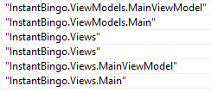
Bootstrap (MainView, View-First)
Set up WinRTContainer
CaliburnApplication.DisplayRootView (View-First)
or DisplayRootViewFor (ViewModel-First)
Create RootFrame and PrepareViewFirst and Navigate to MainView
OnNavigated
LocateForViewType : Looking for MainViewModel instance
LocateTypeForViewType
TransformName: Get all possible names
AssemblySource.FindTypeByNames: Use reflection to get first matching type
IoC.GetInstance : Get the instance from IoC container
Bind MainView and MainViewModel
Notes:
CaliburnApplication
App.xaml.cs

Slide 13


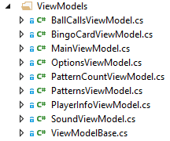

From ContentControl to View
Notes:
To avoid Fat View and ViewModel, we can compose the View by using ContentControl

Slide 14
Actions
Where is ICommand, DelegateCommand, RelayCommand?
“There is no ICommand implementation and there NEVER will be. There is no need. Actions are superior in every way, to the extent that commands can be built on top of them if desired.”
Rob Eisenberg
Notes:
In the MVVM & XAML slide, I mention a little bit about Command Binding which you can find implementation helps in other MVVM frameworks like DelegateCommand in Prism and RelayCommand in MVVM Light.
However, there is no ICommand implementation in Caliburn.Micro.
https://caliburnmicro.codeplex.com/discussions/250844
The Action mechanism allows you to “bind” UI triggers such as a Button’s “Click” event to methods on your ViewModel. It is built on Blend behavior (Microsoft.Xaml.Interactivity or System.Windows.Interactivity in Silverlight).
You can follow the conventions or use Message.Attach and provide more detailed about the action.
Parameters can be specify directly or bound to other FrameworkElements such as DataContext.
Samples in OptionsView

Slide 15
Event Aggregator
Caliburn.Micro comes with publisher/subscriber implementation called EventAggregator.
Class can be either publisher, subscriber, or both.
Class uses IEventAggregator implementations to publish events and subscribe to events.
Class subscribing to events implements IHandle<Message>
Notes:
Publisher/Subscriber pattern or PubSub is a well-known design pattern that promotes loose coupling and scalability.
Caliburn.Micro comes with publisher/subscriber implementation called EventAggregator.
Let’s see the code
OptionsViewModel
Can send message to PlayerInfoViewModel and SoundViewModel
MainViewModel
SoundViewModel
Receives message from OptionsViewModel and MainViewModel

Slide 16
Miscellaneous
How to get get Caliburn.Micro
NuGet (version 1.5.2, based on Windows 8, Callisto)
CodePlex (version 2.0 alpha, based on Windows 8.1, Blend SDK, PCL)
Design-Time support
Screen and Conductor
Coroutines
PCL implementation allows sharing ViewModels in WPF, Silverlight, Windows Store, and Windows Phone apps.
Notes:
Blendability or Design-Time support is also possible. (BingoCardView)
Screen and Conductor: If you have used Caliburn.Micro before, you might notice that I didn’t talk about it at all. They are still there, but unless you want to reuse old code or try to have dynamic views, navigation service should be ok for now.
Coroutines:
A routine that allows multiple entry points for suspending and resuming execution as certain locations. Before C# 5, we can do this by using yield return.
Thanks to the introduction of async / await into WinRT apps the use of coroutines to provide functionality around asynchronous methods will most likely be limited. However Caliburn.Micro IResult's do have one extra feature in that they provide access to the "ActionExectutionContext", this provides access to the View in a more controlled manner and means any view interaction code can be seperate from the View Model.
(OptionsViewModel and OptionsView)
Validation: ConventionManager.ApplyValidation
Caliburn.Micro - is it possible to validate on exceptions with convention-based bindings?
ConventionManager.ApplyValidation = (binding, viewModelType, property) => { binding.ValidatesOnExceptions = true; };
Besides customizing convention, you can customize IoC container, Logger

Slide 17

Thank you!
NashDotNet, sponsors, and everyone for attending my talk!
Rob Eisenberg & his team for Caliburn.Micro on CodePlex: https://caliburnmicro.codeplex.com/
Rob also works on a JavaScript SPA framework called DurandalJS
Materials
WinRT: http://karlk.im/blog/winrt
PowerPoint and Code: http://karlk.im/nashdotnet
Karlkim Suwanmongkol
Questions?
@kimsk
http://karlk.im
karlkim@outlook.com
Notes:
The documentation is pretty good and evolving. There are much more detail and code samples at CodePlex site.
Rob Eisenberg is also working on a JavaScript SPA framework supporting MVVM, messaging, navigation, and so on called DurandalJS which Jason Clark will provide a lab next week.

